Slide 1
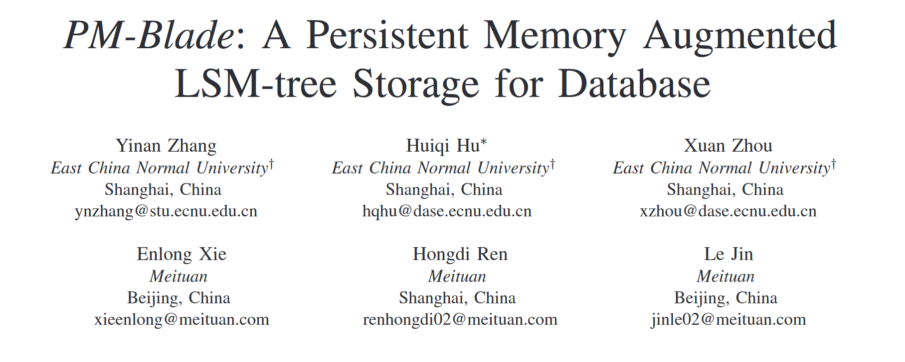
ICDE 2023

Slide 2
Background
LSM-Tree exists three problems.
Read Amplification. (Search data in multiple layers)
Space Amplification. (The same data may be written to the disk multiple times at different levels)
Write Amplification. (compaction lead to write same data multiple times)
Data tables in level-0 are unordered. As the size of level-0 increases, this hurts read performance.
To achieve an overall performance improvement, compaction within level-0 needs to be managed.

Slide 3
Contributions
Employs a high-capacity PM-based level-0 layer to optimize the LSM-tree.
Use the PM-based level-0 to convert unsorted PM tables to sorted ones.
Partition the LSM-tree and perform cost-based compaction in each partition.
Proposed an internal compaction method and a cost-based compaction strategy to boost its read efficiency, reduce its write amplification.
Devised a coroutine-based compaction method, which performs precise scheduling to reduce CPU waiting time and I/O contention.
Outperformed several open-source alternatives on standard benchmarks and a real-world workload of Meituan.

Slide 4
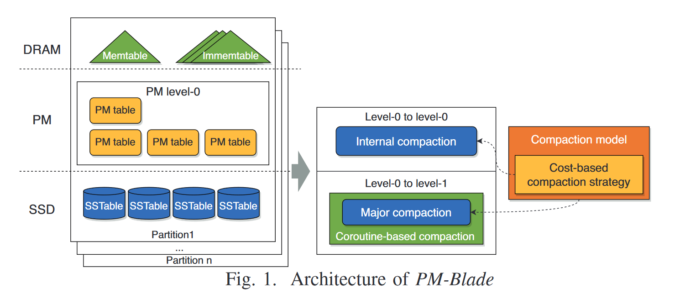
Architecture of PM-Blade
Use PM to store level-0 data, since PM is based on byte addressing, it can achieve ordered tables between level-0 layers with minimal IO cost.

Slide 5
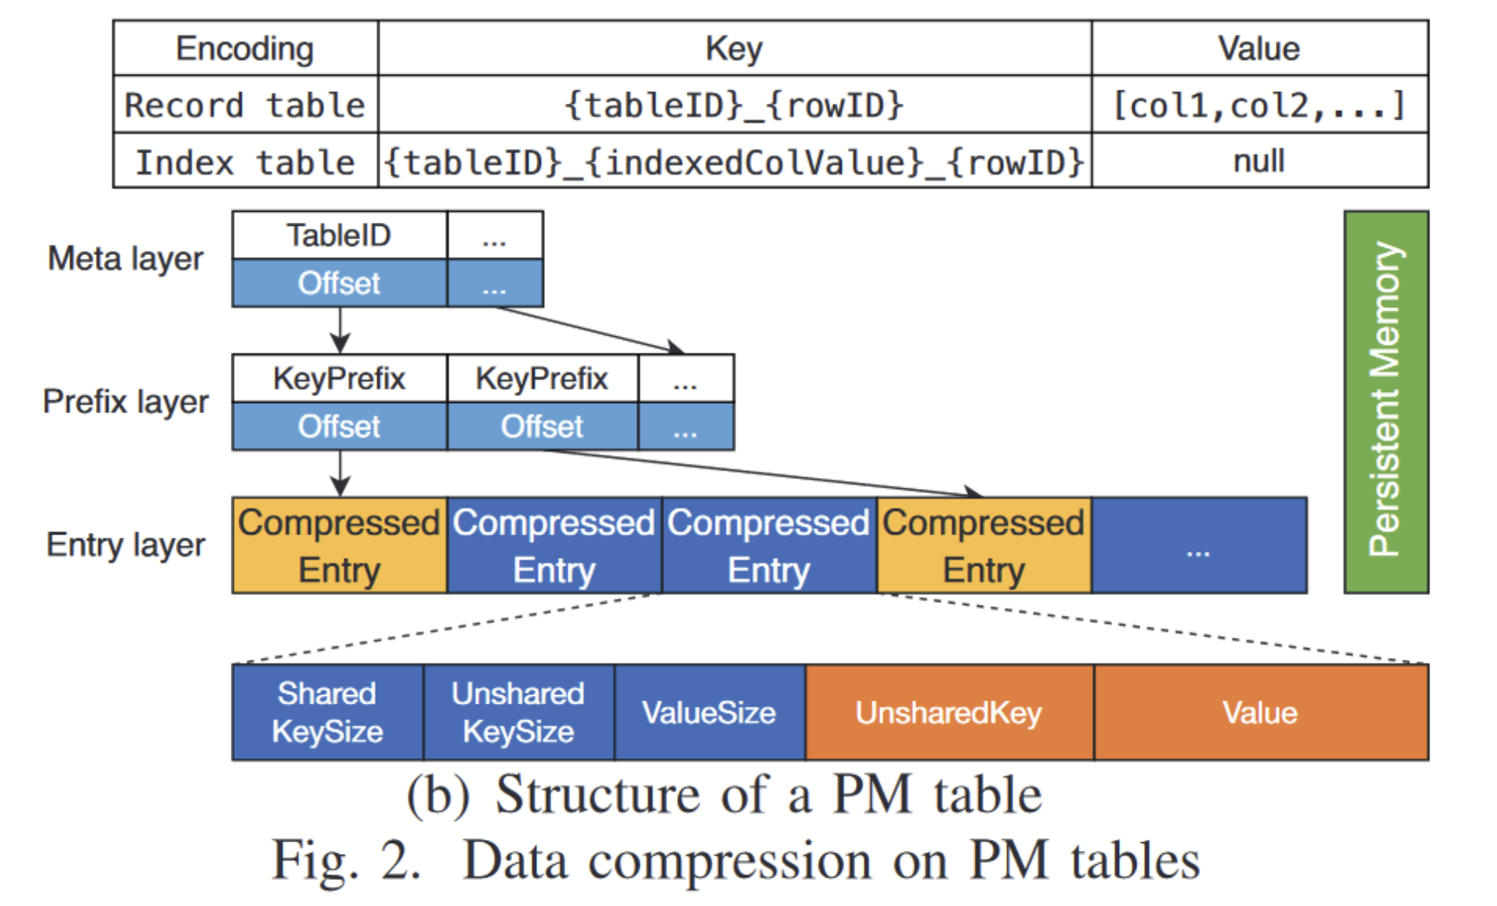
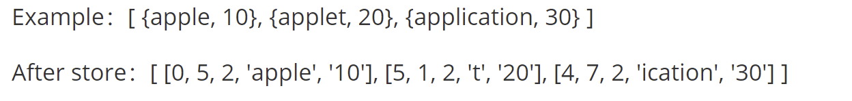
Data storage format of L0 layer

Slide 6
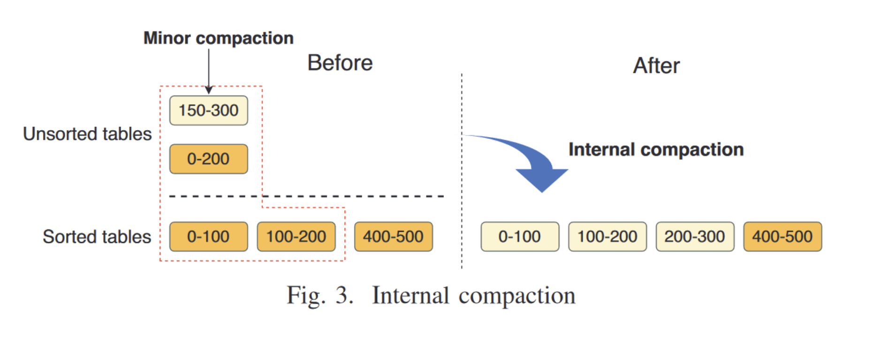
Internal Compaction
Unsorted tables are directly flushed down by Immemtable, with each block being ordered internally.

Slide 7
Cost-based Compaction Strategy
The compaction strategy guides the scheduling of compression threads.
The three objectives of the compression strategy.
Can alleviate the problem of read amplification as the increase of L0 layer PM table.
Make full use of PM space to reduce write amplification issues in lower level merging.
Try to keep warm data in the PM table of L0 layer as much as possible, and reduce the access IO for reading data.

Slide 8
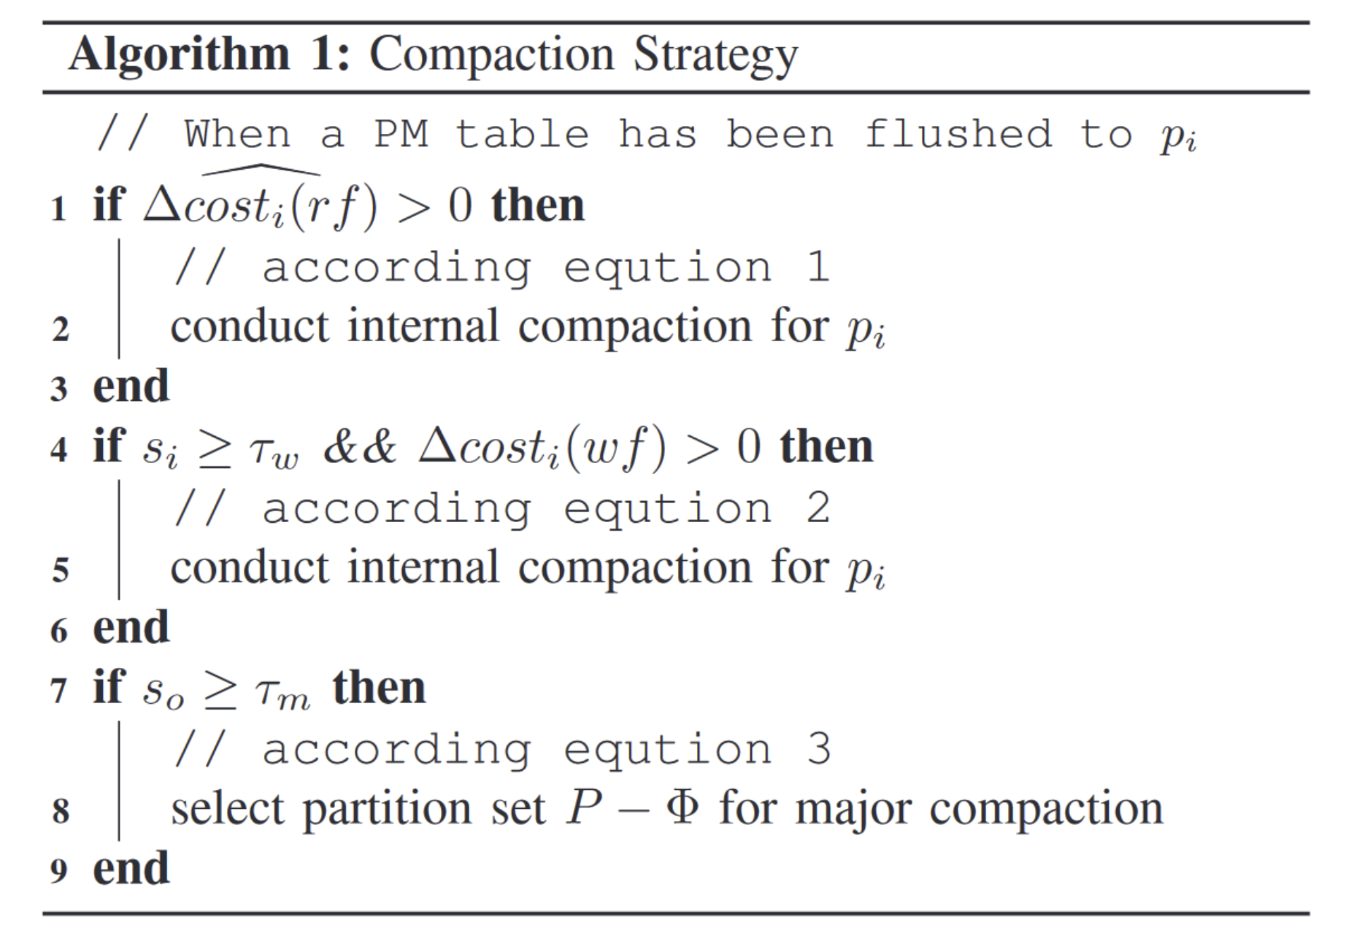
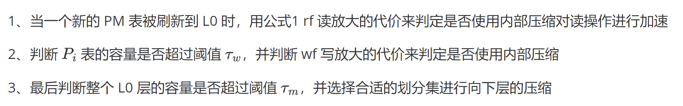
Cost-based Compaction Strategy

Slide 9
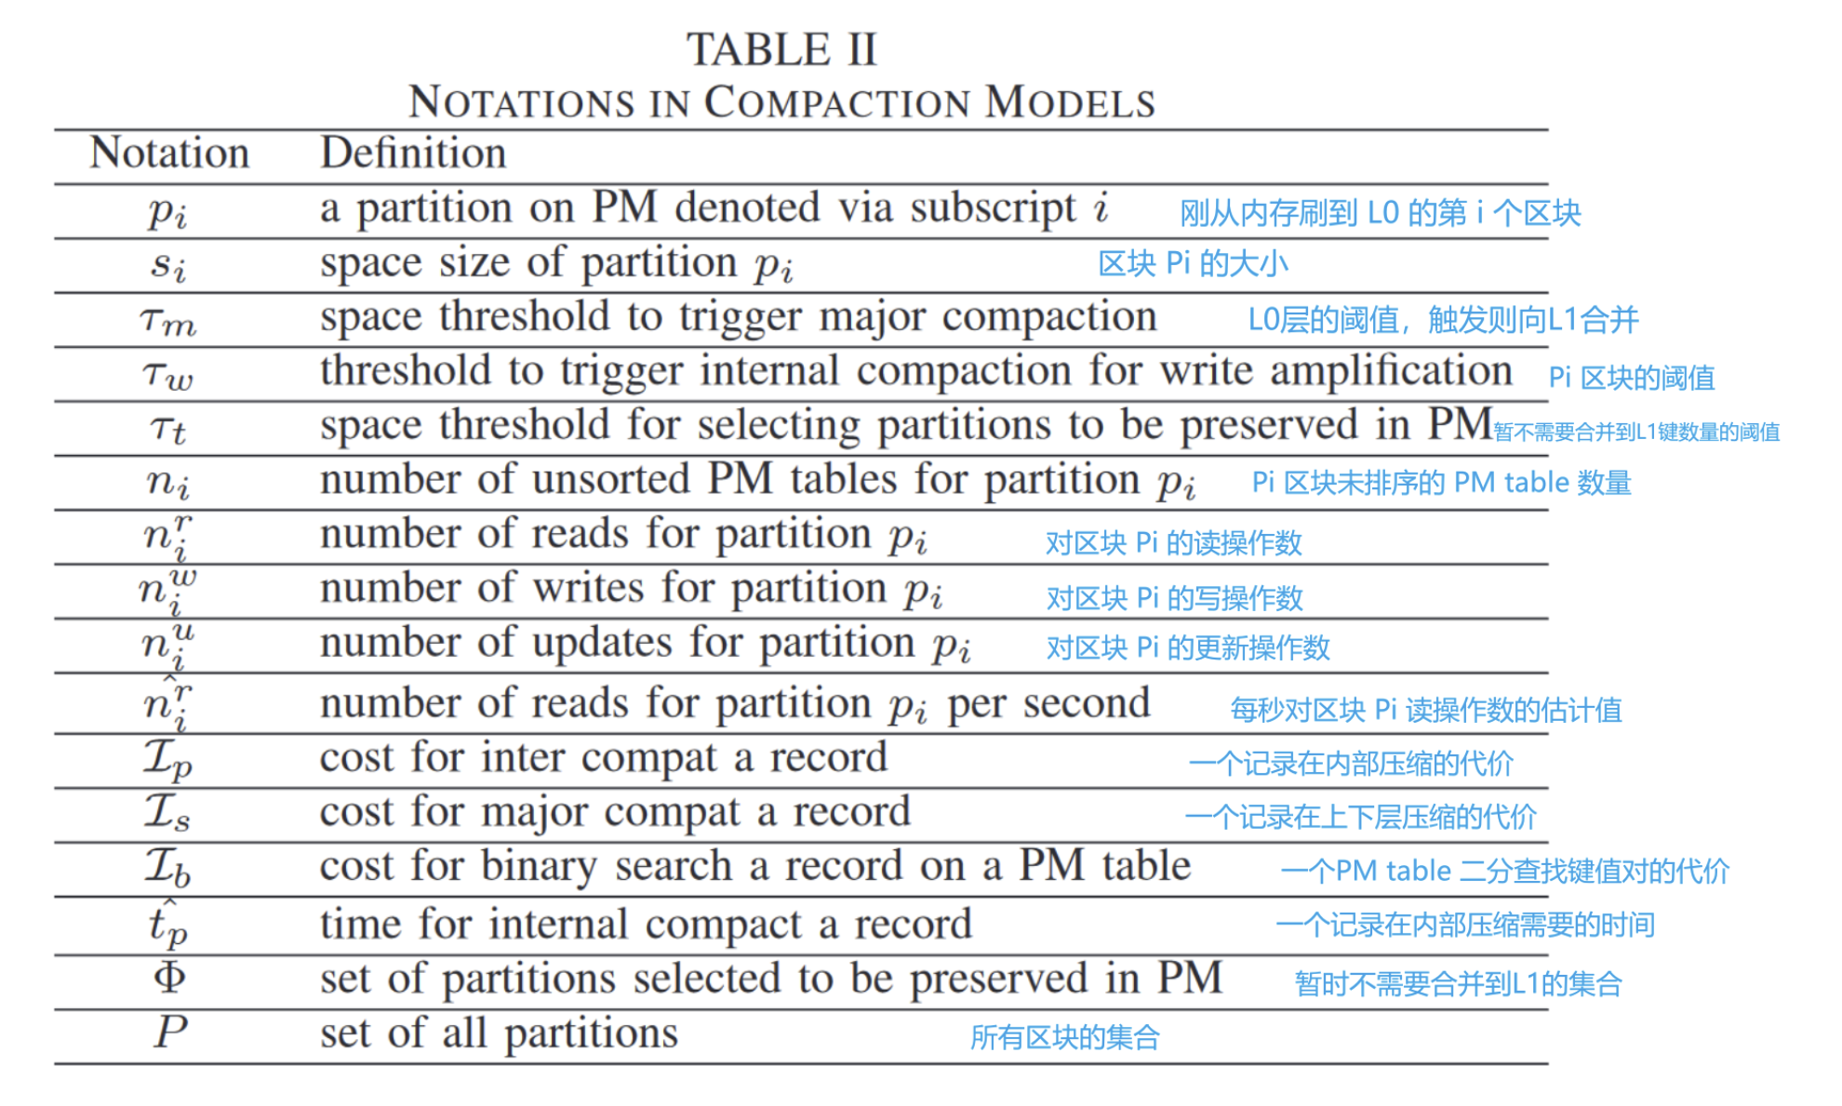
Symbol Explanation

Slide 10
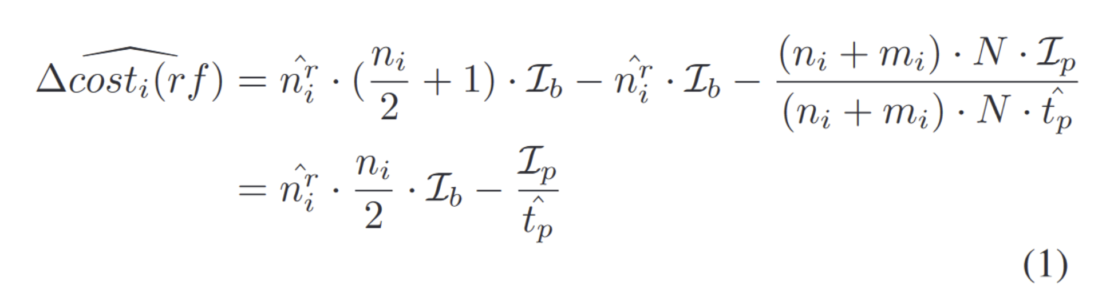
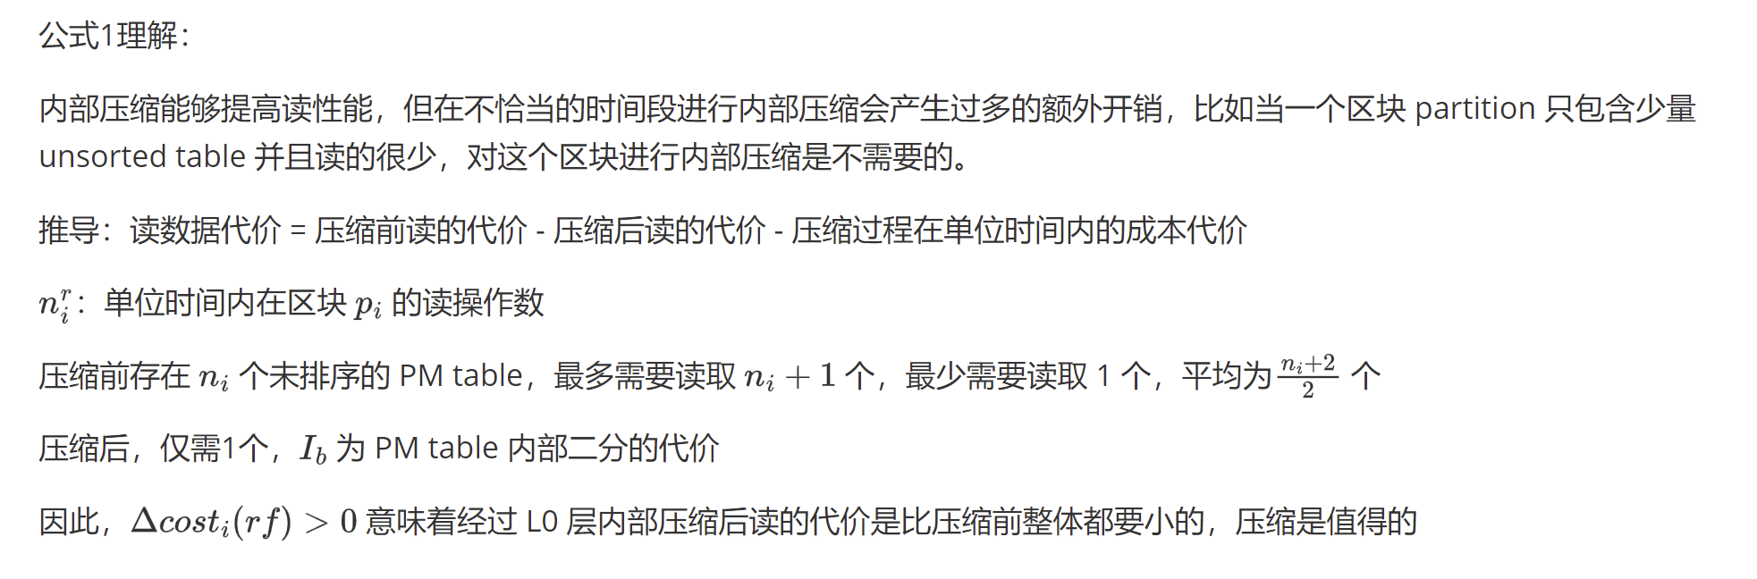
Cost-based Compaction Model Formula 1

Slide 11
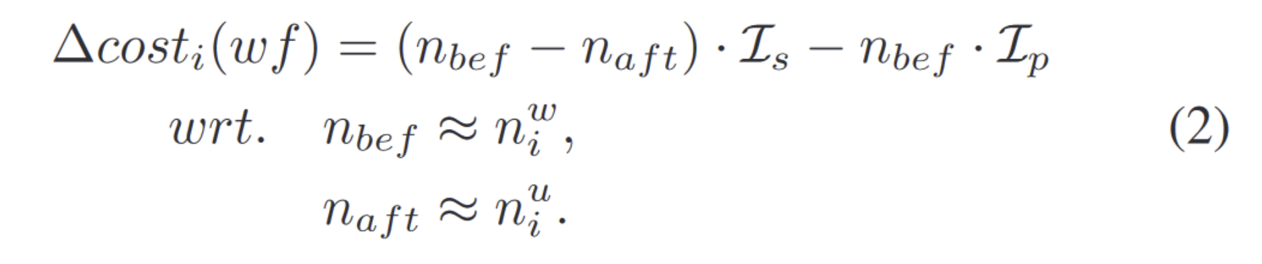
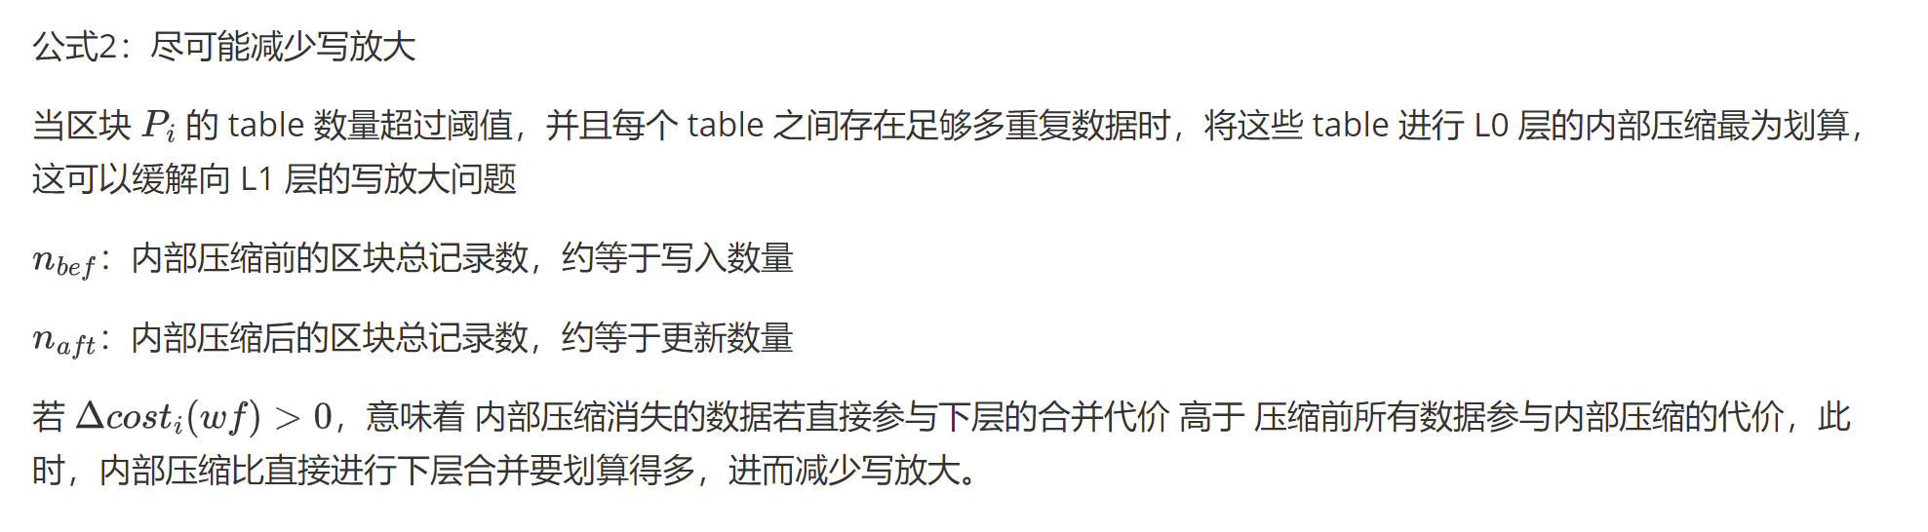
Cost-based Compaction Model Formula 2

Slide 12
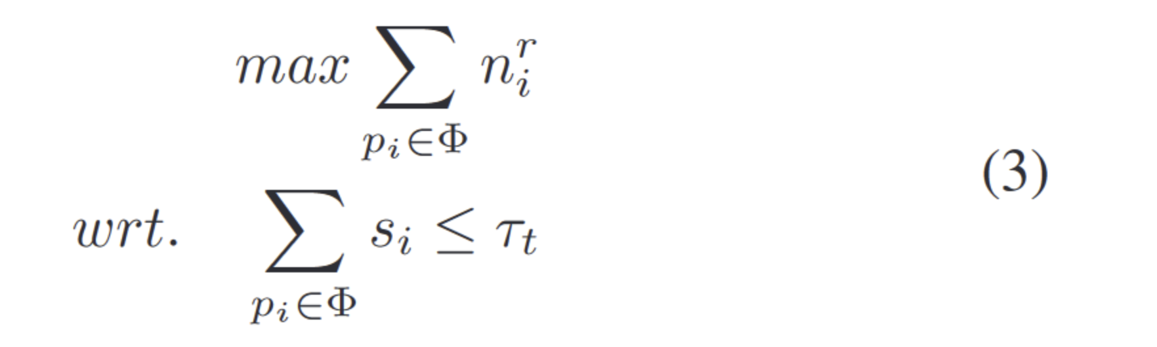
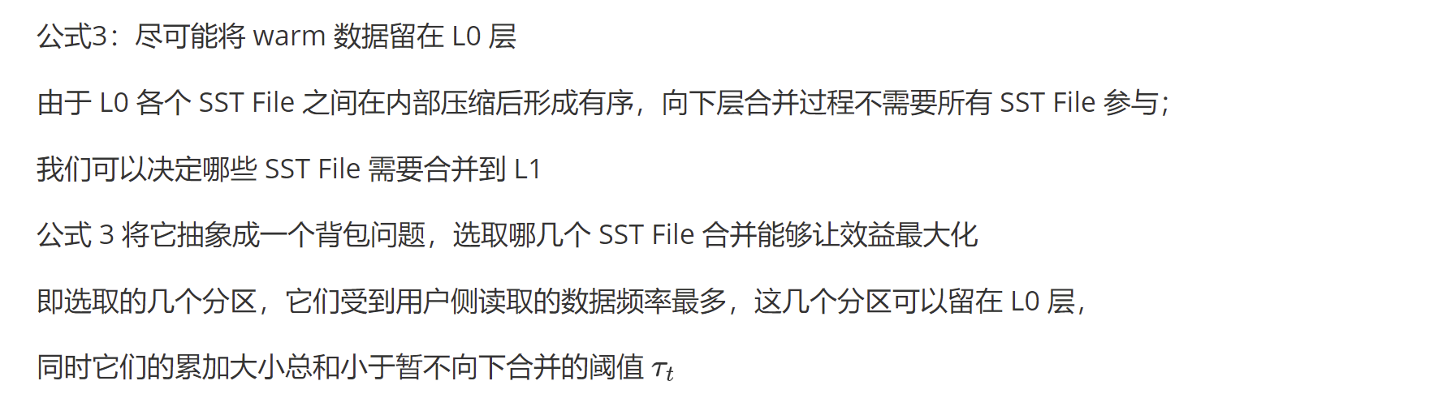
Cost-based Compaction Model Formula 3

Slide 13
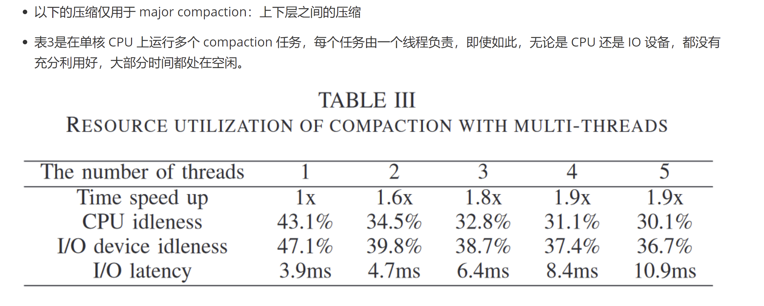
Coroutine-based Compaction

Slide 14
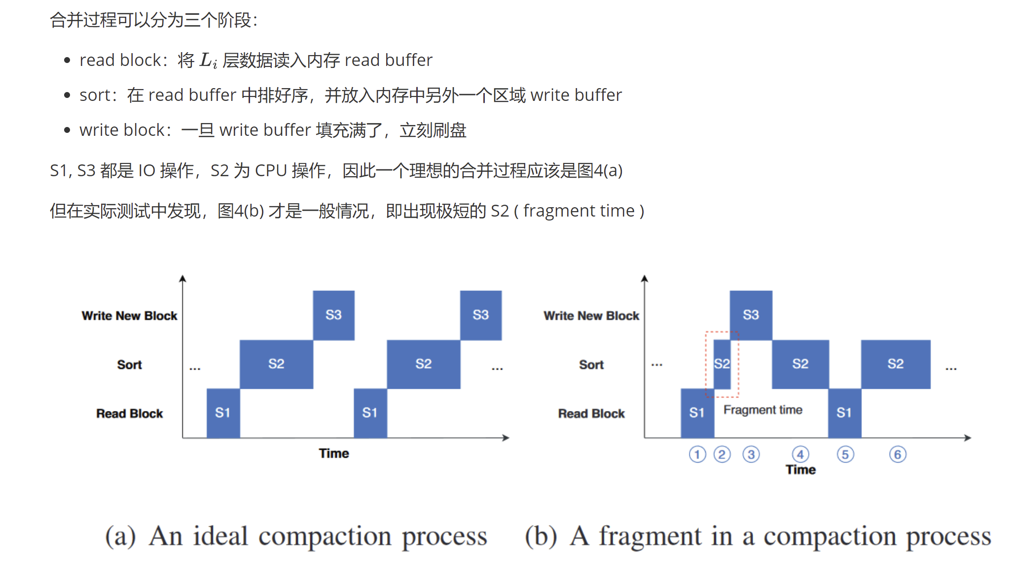
Coroutine-based Compaction

Slide 15
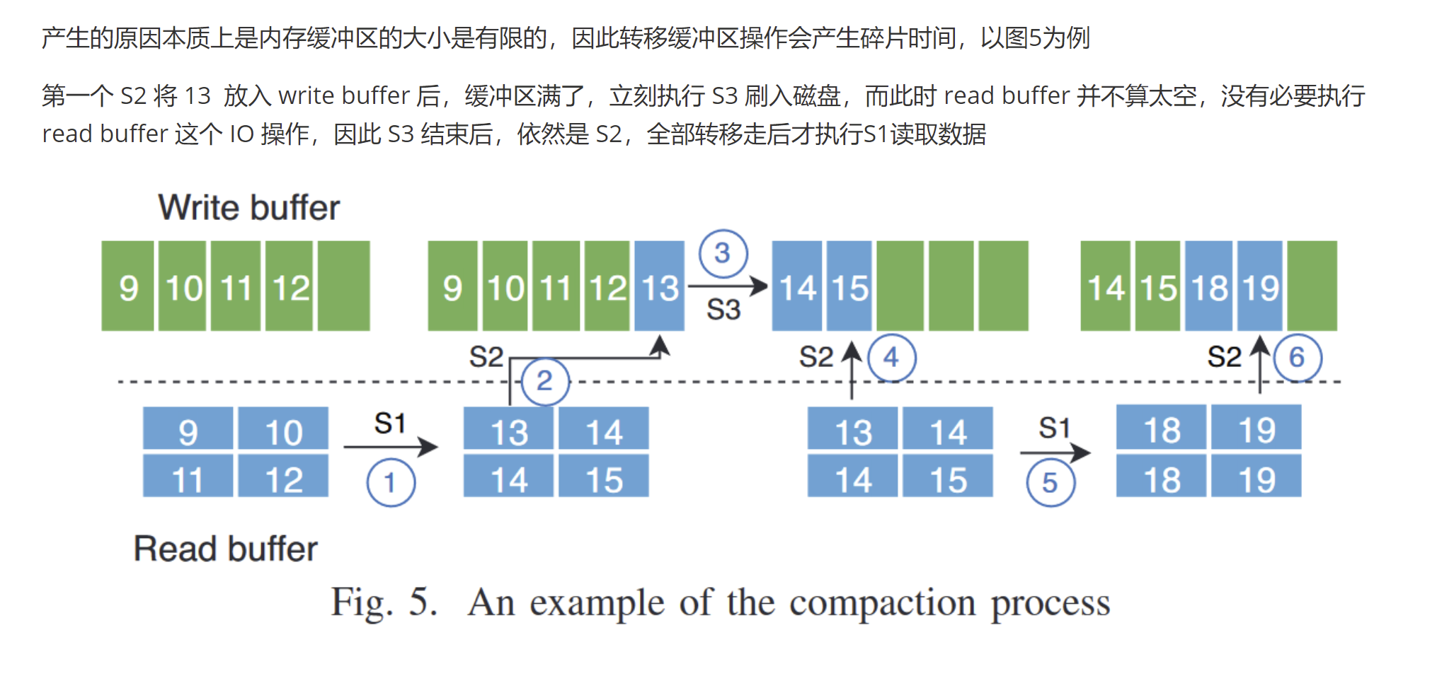
Coroutine-based Compaction

Slide 16
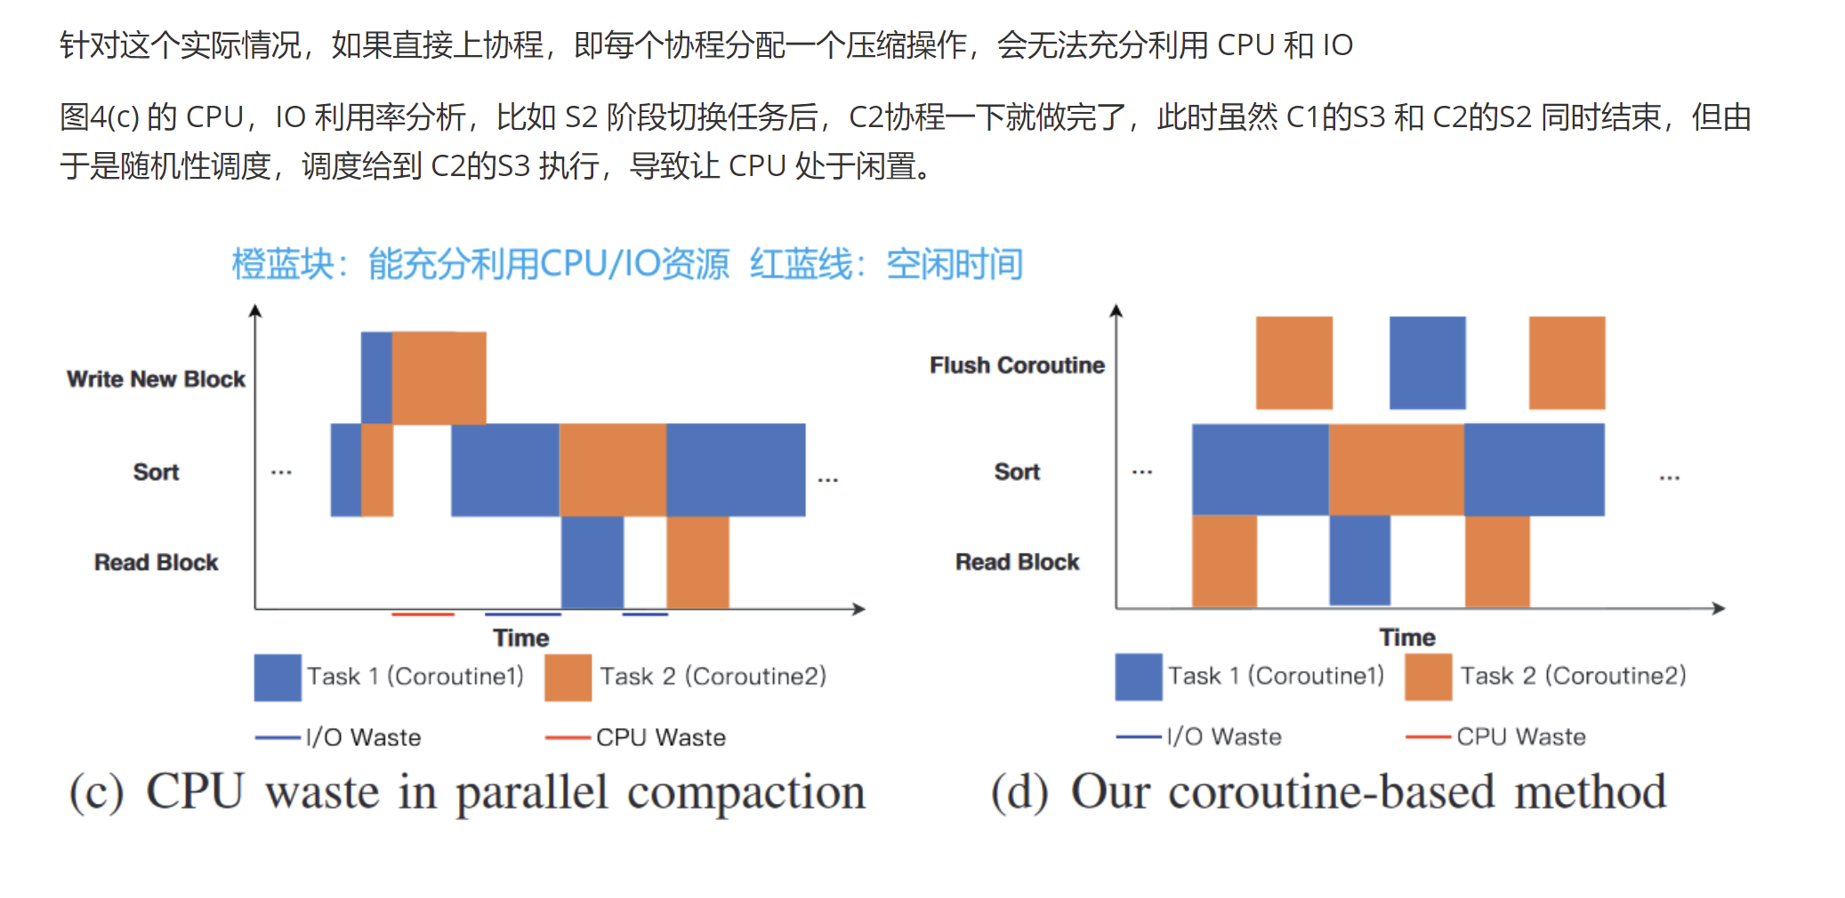
Coroutine-based Compaction

Slide 17
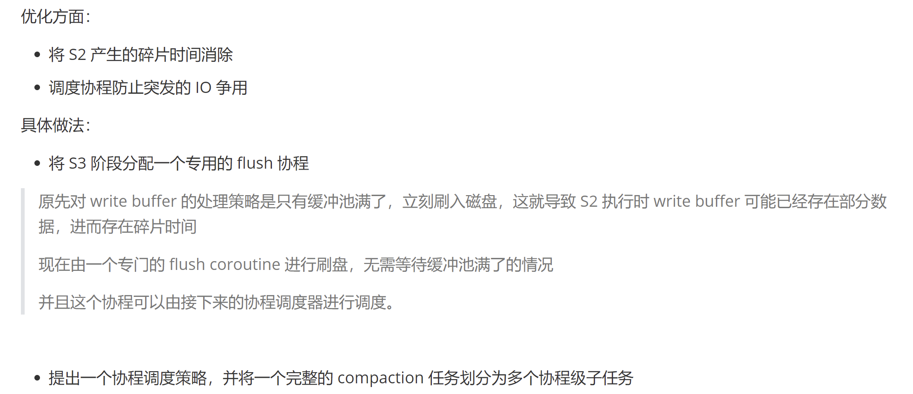
Coroutine-based Method

Slide 18
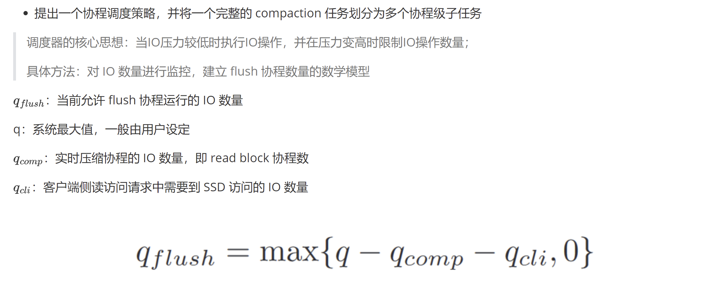
Coroutine-based Method

Slide 19
实验
机器配置
2x Intel(R) Xeon(R) Gold 6240R CPU processors and 128 GB of memory.
1x1TB SSD to store SSTables. one chip of 128 GB Intel Optane DC Persistent Memory.
主要负载
YCSB, db_bench
测试对比的系统
PM-Blade, Rocksdb, MatrixKV (ATC 2020) 华科
测试结果的衡量指标
吞吐量, 利用率（%）, 写放大（GB），延迟（us）

Slide 20
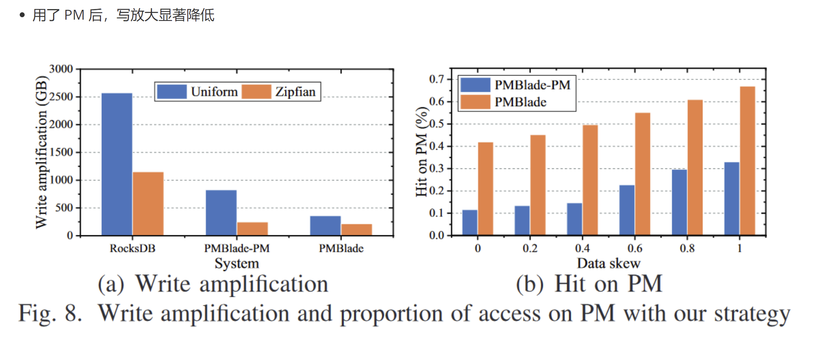
实验1：Write Amplification Comparison

Slide 21
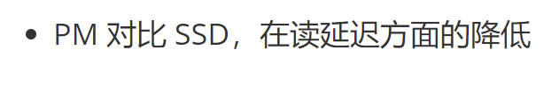
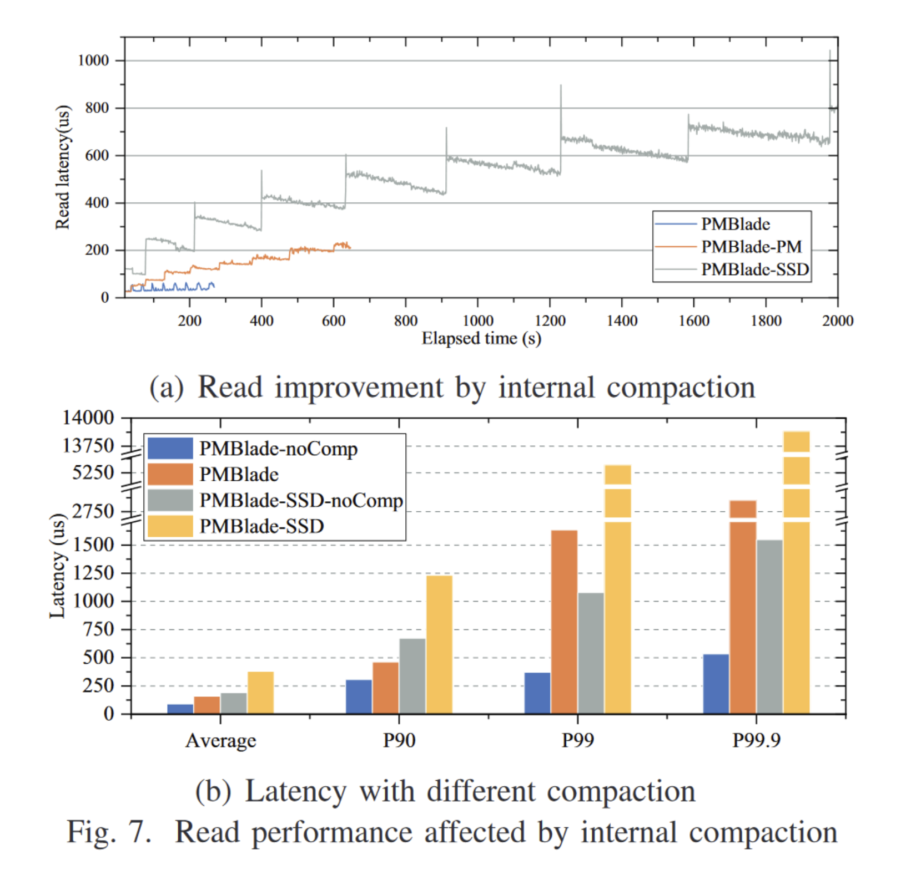
实验2：Read Latency Comparison

Slide 22

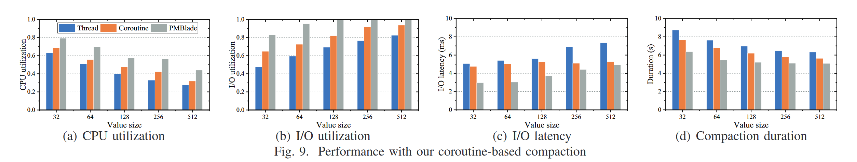
实验3：Schedule Strategy Comparison

Slide 23
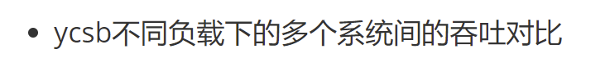
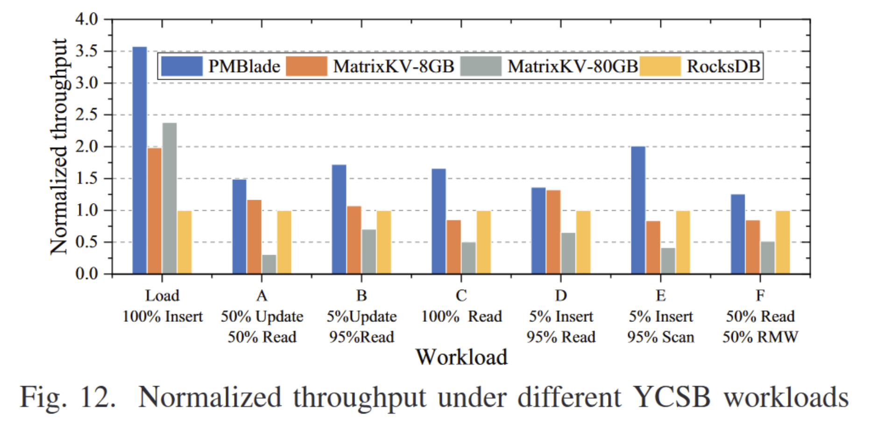
实验4：Throughput Comparison

Slide 24

Thanks

